Slide 1


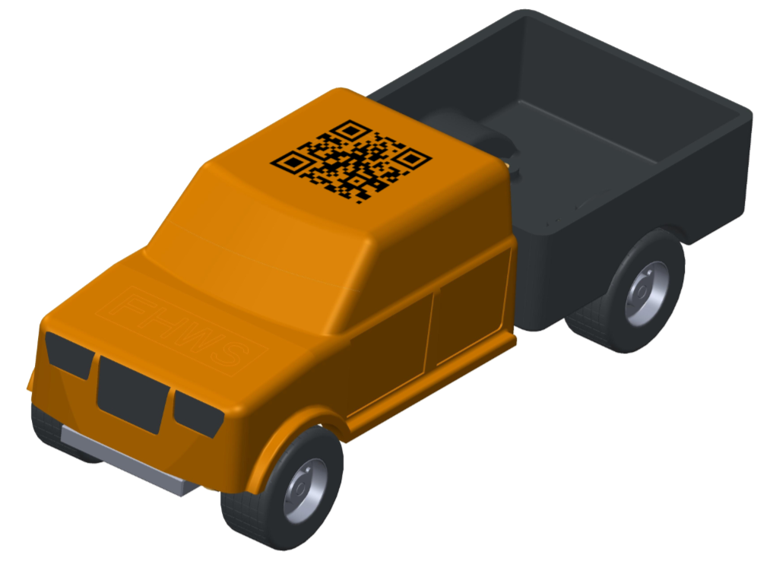
Thesis: Conception and validation of a 3D printed tool for an injection moulding machine
The c-factory‘s production needs to be improved and more diverse!
Your task will be to make a concept, create a prototype and validate a 3D printed tool for our injection moulding machine in order to expand our portfolio.
Betreuung: Prof.-Dr. Christoph Bunsen und Roland Oppelt
Kontakt: christoph.bunsen@fhws.de roland.oppelt@fhws.de

